Slide 1

HEARING AID SYSTEM
Indian Institute of Information Technology, Sricity
DSAA PROJECT
Team MATES :
Iti Tripathi : 201611126
Rishav Chandra vArma : 201601072
Siddhant kushwaha : 201601089
Uday RaJ SAWHNEY: 201601099

Slide 2
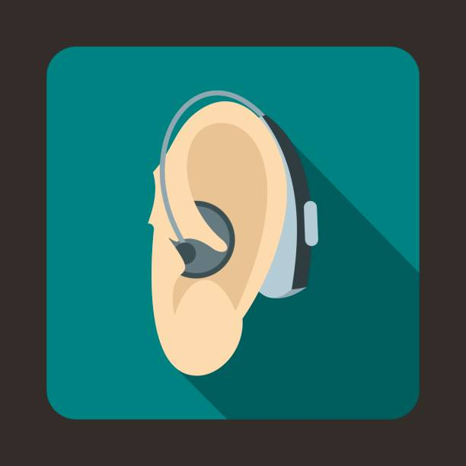
What is digital hearing aid?
Hearing loss is not just a technical loss of volume rather, hearing deficiency can increase sensitivity and reduce tolerance to certain sounds while diminishing sensitivity to others.
A digital hearing aid has a computer inside to control it. The computer memory stores settings for its user. The computer program uses the stored settings to tailor the hearing aid sound to suit the user.
Through the use of digital signal processing, digital hearing aid now offers what the analog hearing aid can’t offer. The stimulation of simple digital hearing aid will be developed using MATLAB programming language.

Slide 3
FLOW CHART FOR HEARING AID
INPUT SPEECH SIGNAL
NOISE ADDITION
NOISE REDUCTION FILTER
OUTPUT SPEECH SIGNAL
AMPLITUDE COMPRESSION
FREQUENCY SHAPER

Slide 4
METHODOLOGY
Noise Addition: If the input speech signal for this system is a clean signal, some noise must be added to model a real situation. So the Additive White Gaussian Noise (AWGN) and random noise are added to the input speech signal by using MATLAB function.
Noise Reduction: To eliminate the noise, a reduction filter function is used in this design. To suppress the noise in the signal, the wavelet filter function is used.
Frequency Filter: The frequency shaper is designed to correct for the loss of hearing at certain frequencies. It applies high gain for higher frequencies and vice versa
Amplitude Compression: Amplitude compression function is the task of controlling the overall gain of a speech amplification system. Amplitude compression will ensure that the amplified signal will not exceed saturation power.

Slide 5
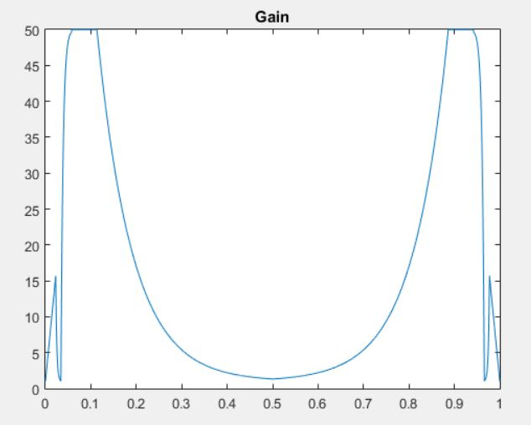
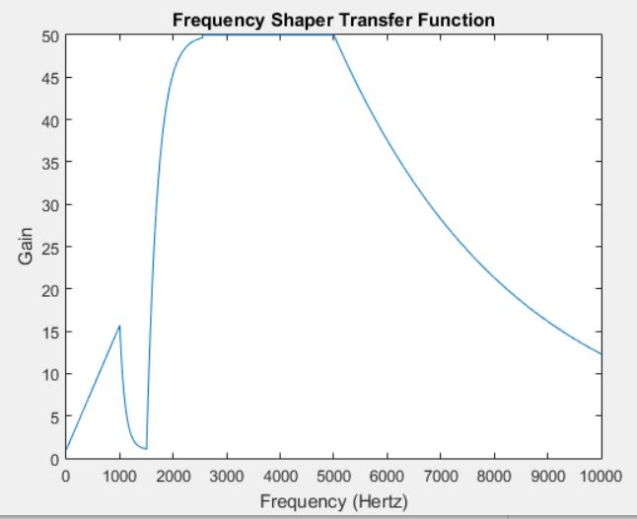
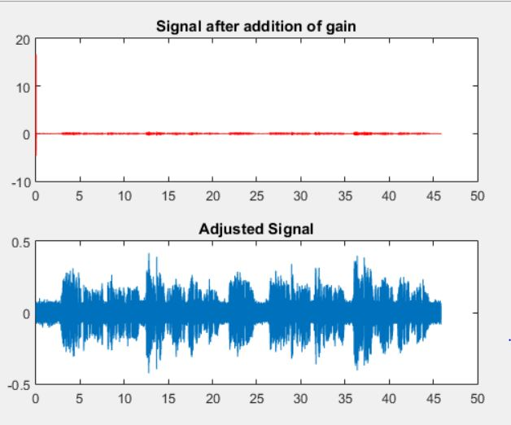
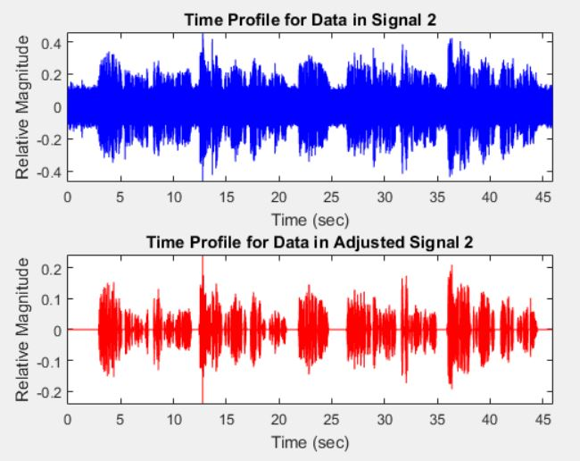
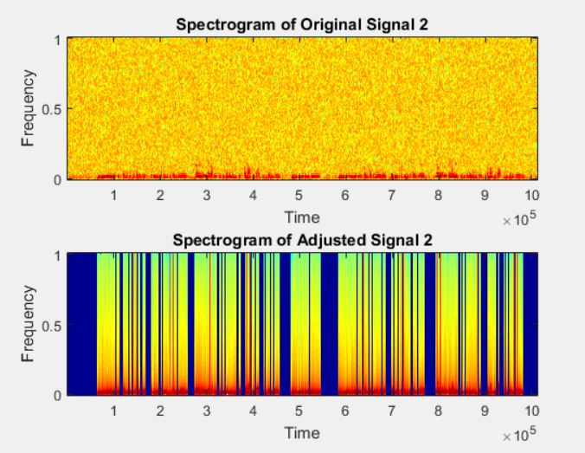
RESULTS

Slide 6
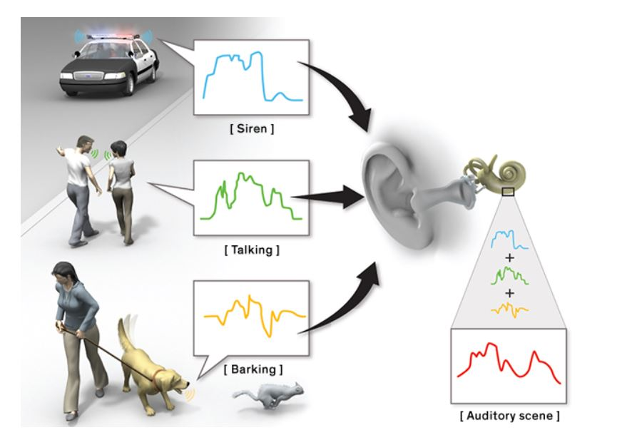
FUTURE SCOPE
Can be improved such that it can intelligently detect the required inputs, according to user’s need.
To improve the quality of the output signal being produced.
To be able to remove different types of noise and make it easier for the person, suffering from the hearing loss, to hear the voice.

